Slide 1
Code Performance Optimization
Presented at Adobe ColdFusion Summit 2023
by Denard Springle

Slide 2
Agenda
What Is Concurrency?
Resource-Efficient Coding Patterns
Caching Strategies (Native CF and CacheBox)
Database Performance Optimizations
Q&A

Slide 3


DENARD SPRINGLE
LOOKING FOR MY NEXT CHALLENGE!
denard.s@3dgeeksolutions.com
CF Developer since v3.1
Polyglot (Java, Node, etc.)
@denardspringleiv

Slide 4
What Is Concurrency?
A measure of how many active requests can be serviced at the same time
The more concurrent requests you have the more resources (RAM, CPU and I/O) will be required
Horizontal Scaling
Maximizing the available RAM, CPU and I/O in a single server (tall server)
Configuring OS, application servers, DBs and containers for best resource utilization
Optimizing application code to use as few resources as possible
Vertical Scaling
Load balancing two or more horizontally scaled servers (and/or containers) to achieve higher concurrency

Slide 5
Resource-Efficient Coding Patterns
Use modern coding techniques (OO, (H)MVC, FP, etc.)
Use script vs tags (except in views) – faster compilation and execution
Avoid scope cascading
Implement the fast exit strategy
Break (out of loops) and Continue (over loops)
Avoid the string processor ( variable vs. #variable# / “#variable#” )
Avoid creating unnecessary variables
Use threads (and parallel, in Lucee and ACF2023+)
Implement Java directly
Use caching strategies

Slide 6
Avoid Scope Cascading
Always SCOPE your variables (e.g. form.myVariable vs myVariable)
local, arguments, thread local (inside threads), query (inside query loop), thread, variables, cgi, cffile, url, form, cookie, client – When no scope is provided, ColdFusion has to search through scopes sequentially until it finds a matching variable. This is time consuming and potentially unsafe.
To speed up execution, as well as eliminate ambiguity and potential security threats, always fully scope the variables you use. The only exception is the variables scope, which ColdFusion always scans first and is implied when defining any variable outside of a function.
var scope variables inside of functions. var myArray = [];

Slide 7
Delayed Exits Hold Requests Open Longer
if( structKeyExists( url, ‘bob’ ) ) {
// do something with url.bob
if( structKeyExists( url, ‘jane’ ) ) {
// do something with url.jane
if( structKeyExists( url, ‘zed’ ) {
// do something with url.bob, url.jane, url.zed
} else {
// exit
} else {
// exit
} else {
// exit
}

Slide 8
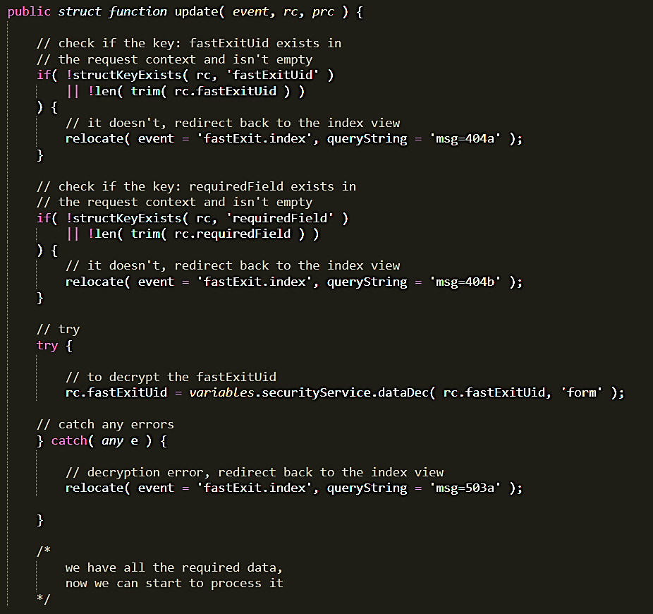
Fast Exit Strategy
End requests that cannot be processed as quickly as possible to allow other pending requests to be processed

Slide 9
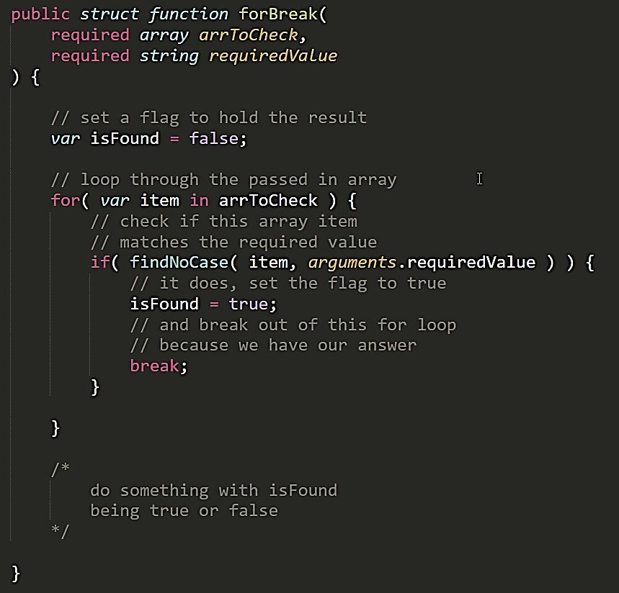
Break
break; out of loops (for, while) and decision trees (switch { case }) once you have satisfied a condition

Slide 10
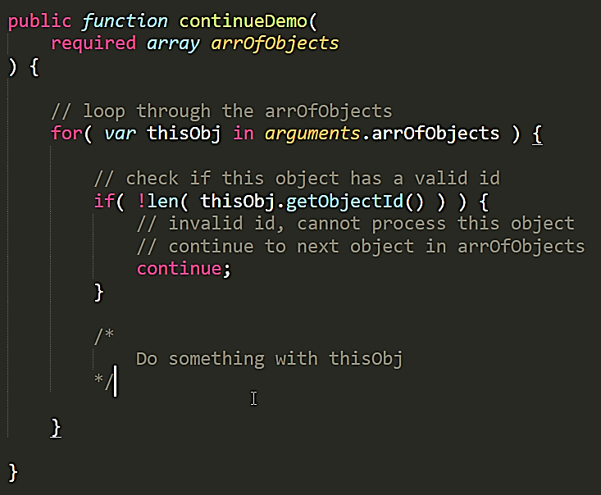
Continue
continue; over loops when data cannot be processed

Slide 11
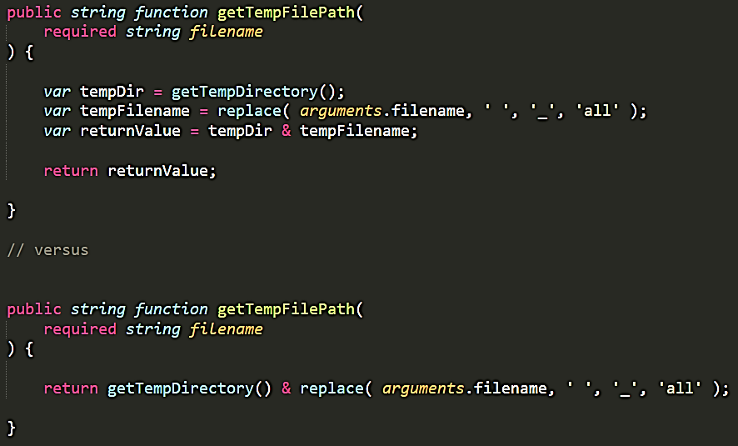
Avoid Variable Creation
Variable construction consumes RAM and CPU cycles, avoid creating them wherever possible

Slide 12

Know your language
Avoid CPU/RAM intensive functions when alternatives exist structKeyExists() vs structFind() a++ vs incrementValue() ?: ternary operator vs iif()
Use functional programming techniques e.g. map(), reduce(), filter(), each() – they’re typically faster than loops
ColdFusion is a tool in your toolbelt. You should master it as you would any other tool.
I IS JEDI
I IS JEDI

Slide 13
Caching Strategies
What is cache?
A way to store (in RAM, on disk, etc.) and retrieve frequently accessed but rarely changing data instead of generating that data every time, especially data that increases resource utilization on the application or database server
Why use cache?
Reduces load on application and database resources, allowing greater throughput for requests that require just-in-time data rendering and handling
Increases the performance and responsiveness of your application by caching complex calculated results, or even just the queries that make up a frequently requested but not time sensitive pages of data

Slide 14
Native Cache Functions
// get your cached data
var myData = cacheGet( 'myCachedData' );
// check if your cached data still exists, or if we’re forcing a reload if( isNull( myData ) || arguments.clearCache == true ) {
// it doesn’t exist, or we are reloading, get the data into myData myData = doSomeComplexProcess();
// put it in the cache for an hour cachePut( 'myCachedData', myData, createTimeSpan( 0, 1, 0, 0 ) );
} // do something with myData

Slide 15
User specific caching pattern
// get your cached data
var myData = cacheGet( 'myCachedData_’ & arguments.userId );
// check if your cached data still exists, or if we’re forcing a reload if( isNull( myData ) || arguments.clearCache == true ) {
// it doesn’t exist, or we are reloading, get the data into myData myData = doSomeComplexProcess();
// put it in the cache for an hour cachePut(
'myCachedData_’ & arguments.userId,
myData,
createTimeSpan( 0, 1, 0, 0 ) );
} // do something with myData

Slide 16
Using a cache service layer
// get your cached data
var myData = cacheService.get( 'myCachedData' );
// check if your cached data still exists, or if we’re forcing a reload if( isNull( myData ) || arguments.clearCache == true ) {
// it doesn’t exist, or we are reloading, get the data into myData myData = doSomeComplexProcess();
// put it in the cache for an hour cacheService.set( 'myCachedData', myData, '1h' );
} // do something with myData

Slide 17
CacheBox
CacheBox by Ortus provides multiple advanced features:
Cache Aggregators – Ability to aggregate multiple caching engines
Simple API – use a common set of functions get(), set()across aggregate engines
Fully Configurable – convention and runtime configuration options
Cache Monitoring – Dashboard and commands panel
Use with or without ColdBox and other products in the *Box ecosystem

Slide 18
Database Performance Optimization
Use Stored Procs
Index Relationship Keys
Utilize Dirty Reads

Slide 19
Use Stored Procedures
Take advantage of database server CPU/RAM resources
Stored procedures, on average, execute faster than queries – q stored procedure is an execution plan
In DAO the Create, Read, Update and Delete (CRUD) functions should use stored procedures
You can use tools liks SSMS Tools Pack to generate CRUD stored procedures quickly https://www.ssmstoolspack.com/Download

Slide 20
Index Relationship Keys
Tables should use integer primary and relationship (foreign) keys
Integer indexes are faster than alternatives like GUID and suffer less fragmentation
By indexing relationship keys you expedite the process of finding relational data when doing JOINs

Slide 21
Utilize Dirty Reads
When having the most recent data is inconsequential to the result of a read, use a dirty read to prevent locking
In MSSQL use WITH (NOLOCK)
The WITH (NOLOCK) table hint is used to override the default transaction isolation level of the table or the tables within the view in a specific query. The query will consume less memory in holding locks against that data and no deadlock will occur against the queries that are requesting the same data from that table.

Slide 22
GoFundMe Donors
Thomas Long
Aaron DeRenard
Daniel Fredericks
Kevin Wright
Igal Sapir
Thank you for helping get me to Vegas to speak today!

Slide 23

Thank you for attending! Questions?

